Slide 1
Part 1
Foundations of Cryptography and Block Cipher Techniques
OSI Security Architecture - Classical Encryption techniques – Cipher Principles – Data Encryption Standard – Block Cipher Design Principles and Modes of Operation - Evaluation criteria for AES –AES Cipher – Triple DES – Placement of Encryption Function – Traffic Confidentiality-Case study on Barclay’s Bank

Slide 2
1.Introduction
Computer Security - generic name for the collection of tools designed to protect data.
Network Security - measures to protect data during their transmission.
Internet Security - measures to protect data during their transmission over a collection of interconnected networks.
Cryptography - secure communication techniques that allow only the sender and intended recipient of a message to view its contents.
Prevents unauthorized access to information.
The prefix “crypt” means “hidden” and suffix graphy means “writing”.

Slide 3
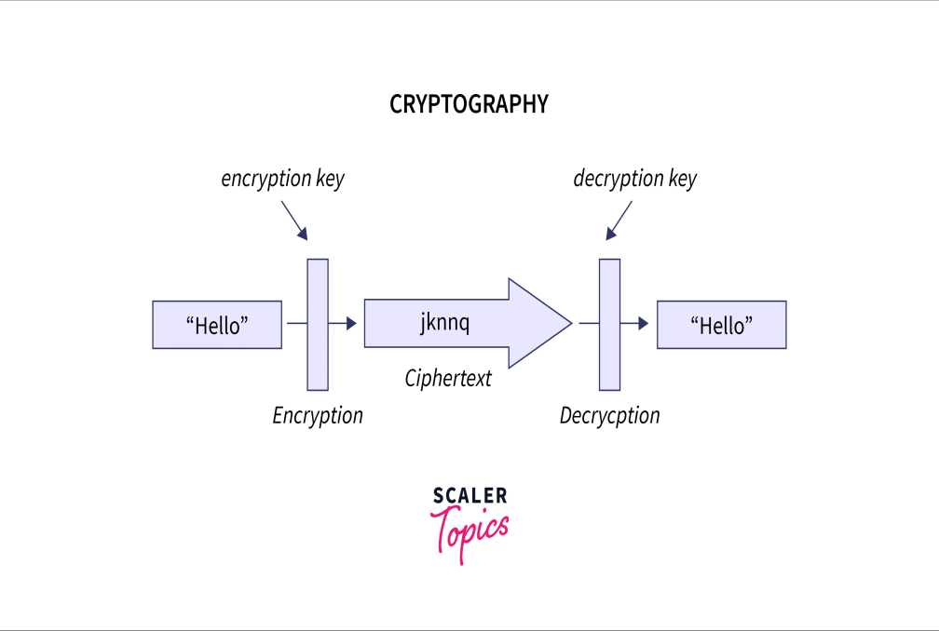
Cryptography generally deals with the study and practice of techniques for ensuring secure communication between two parties in the presence of a third party called adversaries
Below image to visualize the encryption process:

Slide 4
As we see in the above figure sender wants to send a "hello" message and encryption is done on the sender to convert the sender's message into unreadable format(cipher text) using the encryption key.
The message of the sender also known as plain text is converted into an unreadable form by using a key ‘k’, that unreadable resultant text is called cipher text. And this whole process is known as encryption.
At the receiver side cipher text is received and that cipher text is again converted into plain text using the decryption key. Decryption is the reverse process of encryption.
In decryption, at the receiver end cipher text is converted into plain text using the key, so the receiver can understand it.

Slide 5
Now let us understand the terms secure communication and adversary one by one.
Secure Communication generally refers to rules and regulations that ensure that the data shared between two communicating parties can not be retrieved by the adversary.
In cryptography, an adversary refers to a malicious entity, whose target is to access data by threatening the protocols of cyber security.
Cryptography deals with the creation and analysis of rules to prevent the third party from retrieving private information shared between two parties.

Slide 6
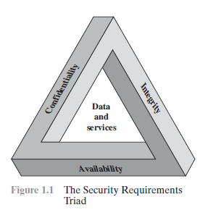
Computer Security Concepts
The NIST Computer Security Handbook [NIST95] defines the term computer security as follows:
The protection afforded to an automated information system in order to attain the applicable objectives of preserving the integrity, availability and confidentiality of information system resources.
Includes hardware, software, firmware, information/ data and telecommunications.

Slide 7
Computer Security Concepts
Confidentiality: This term covers two related concepts:
1.Data Confidentiality: Assures that private or confidential information is not disclosed to unauthorized individuals.
2.Privacy: Assures that individuals control or influence on informations related to them.
Integrity: This term covers two related concepts:
1.Data integrity: Assures that information and programs are changed only in a specified and authorized manner.
2.System integrity: Assures that a system performs its intended function in an unimpaired manner.
Availability: Assures that systems work promptly and service is not denied to authorized users.
Contributed by Himanshu (@nycanshu)

Slide 8
Types of Computer security
1. Cyber Security: Cyber security means securing our computers, electronic devices, networks , programs, systems from cyber attacks. Cyber attacks are those attacks that happen when our system is connected to the Internet
2. Information Security: Information security means protecting our system’s information from theft, illegal use and piracy from unauthorized use. Information security has mainly three objectives: confidentiality, integrity, and availability of information.
3. Application Security: Application security means securing our applications and data so that they don’t get hacked and also the databases of the applications remain safe and private to the owner itself so that user’s data remains confidential.
4. Network Security: Network security means securing a network and protecting the user’s information about who is connected through that network. Over the network hackers steal, the packets of data through sniffing and spoofing attacks, man in the middle attack, etc, and misuse the data for their benefits.

Slide 9
2.OSI Security Architecture
ITU-T X.800 “Security Architecture for OSI(Open Systems Interconnection)” defines a systematic way of defining and providing security requirements.
The OSI (Open Systems Interconnection) Security Architecture defines a systematic approach to providing security at each layer
These security services and mechanisms help to ensure the confidentiality, integrity, and availability of the data
3 aspects of security in OSI includes:
A.Security Attack - any action that compromises the security of information owned by an organization.
Types: i.Active Attack and ii.Passive Attack.
B.Security Mechanism - mechanism to detect, prevent and recover from a security attack.
C.Security Services – a service that enhances the security of data processing systems and information transfers of an organization.

Slide 10
A.Security Attacks
i.Active Attacks - a network exploit in which a hacker attempts to make changes to data on the target or data en route to the target.
Active attacks refer to types of attacks that involve the attacker actively disrupting or altering system, network, or device activity
Active attacks are typically focused on causing damage or disruption, rather than gathering information or intelligence.
Here, both the sender and receiver have no clue that their message/ data is modified by some third-party intruder.
The message/ data transmitted doesn’t remain in its usual form and shows deviation from its usual behavior. This makes active attacks dangerous as there is no information provided of the attack happening in the communication process and the receiver is not aware that the data/ message received is not from the sender.

Slide 11
Active attacks are further divided into four parts based on their behavior:
Masquerade is a type of attack in which the attacker pretends to be an authentic sender in order to gain unauthorized access to a system. This type of attack can involve the attacker using stolen or forged credentials, or manipulating authentication or authorization controls in some other way.
Replay is a type of active attack in which the attacker intercepts a transmitted message through a passive channel and then maliciously or fraudulently replays or delays it at a later time.
Modification of Message involves the attacker modifying the transmitted message and making the final message received by the receiver look like it’s not safe or non-meaningful. This type of attack can be used to manipulate the content of the message or to disrupt the communication process.
Denial of service (DoS) attacks involve the attacker sending a large volume of traffic to a system, network, or device in an attempt to overwhelm it and make it unavailable to legitimate users.

Slide 12
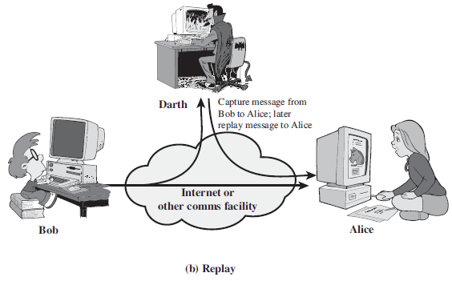
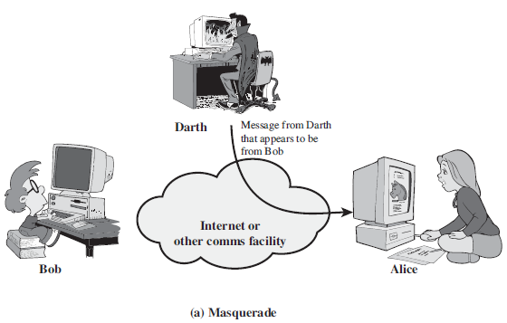

Slide 13
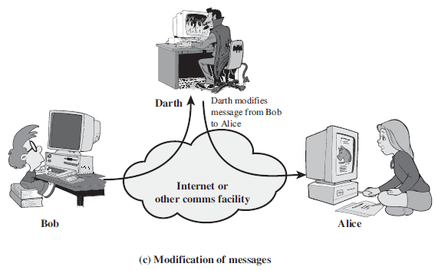
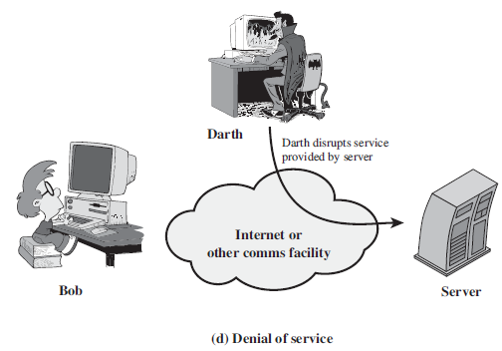
Active Security Attacks

Slide 14
Passive Attack:
Attacks in which a third-party intruder tries to access the message/ content/ data being shared by the sender and receiver by keeping a close watch on the transmission or eave-dropping the transmission .
Involves the attacker observing or monitoring system, network, or device activity without actively disrupting or altering it.
Typically focused on gathering information or intelligence, rather than causing damage or disruption.
Both the sender and receiver have no clue that their message/ data is accessible to some third-party intruder.
The message/ data transmitted remains in its usual form without any deviation from its usual behavior.
This makes passive attacks very risky as there is no information provided about the attack happening in the communication process.
One way to prevent passive attacks is to encrypt the message/data that needs to be transmitted, this will prevent third-party intruders to use the information though it would be accessible to them

Slide 15
Passive attacks are further divided into two parts based on their behavior:
Eavesdropping
This involves the attacker intercepting and listening to communications between two or more parties without their knowledge or consent. Eavesdropping can be performed using a variety of techniques, such as packet sniffing, or man-in-the-middle attacks
Traffic analysis
This involves the attacker analyzing network traffic patterns and metadata to gather information about the system, network, or device. Here the intruder can’t read the message but only understand the pattern and length of encryption.

Slide 16
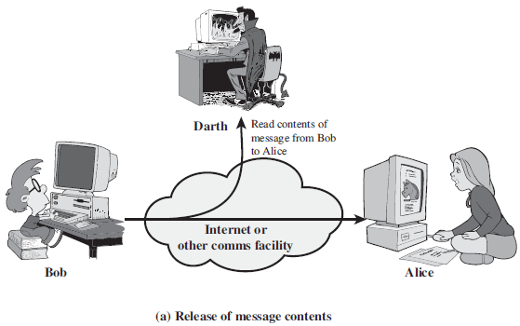
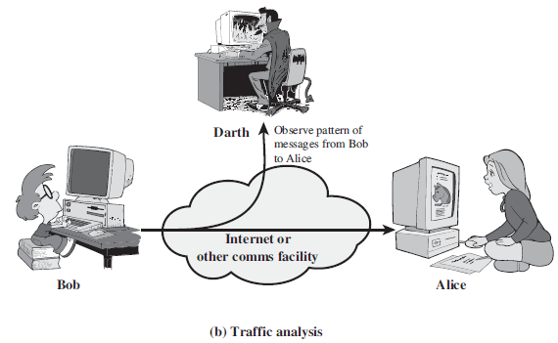
A.Security Attacks
ii.Passive Attacks - A Passive attack attempts to learn or make use of information from the system but does not affect system resources.
In the nature of eavesdropping on or monitoring of transmission.
Examples: Release of message content, Traffic Analysis.

Slide 17
B.Security Mechanisms
To detect, prevent, or recover from a security attack.
No single mechanism will support all required services.
Most important element that underlies many of the security mechanisms is cryptographic techniques that includes:
Specific security mechanisms
Encipherment, digital signatures, access controls, data integrity, authentication exchange, traffic padding, routing control, notarization.
Pervasive security mechanisms
Trusted functionality, security labels, event detection, security audit trails, security recovery.

Slide 18
C.Security Services
To enhance security of data processing systems and information transfers of an organization.
Intended to counter security attacks with one or more security mechanisms.
X.800
A service provided by a protocol layer of communicating open systems, which ensures adequate security of the systems or of data transfers.
RFC 2828
A processing or communication service provided by a system to give a specific kind of protection to system resources.

Slide 19
C.Security Services
Authentication - assurance that the communicating entity is the one claimed.
Access Control - prevention of the unauthorized use of a resource.
Data Confidentiality – protection of data from unauthorized disclosure.
Data Integrity - assurance that data received is as sent by an authorized entity.
Non-Repudiation - protection against denial by one of the parties in a communication.
Availability – resource accessible / Usable.

Slide 20
Below listed are the benefits of OSI Architecture in an organization:
Providing Security:
OSI provides the needed security and safety, preventing potential threats and risks.
Managers can easily take care of the security and there is hassle-free security maintenance done through OSI Architecture.
2. Organising Task:
The OSI architecture makes it easy for managers to build a security model for the organization based on strong security principles.
Managers get the opportunity to organize tasks in an organization effectively.
3. Meets International Standards:
Security services are defined and recognized internationally meeting international standards.
The standard definition of requirements defined using OSI Architecture is globally accepted.

Slide 21
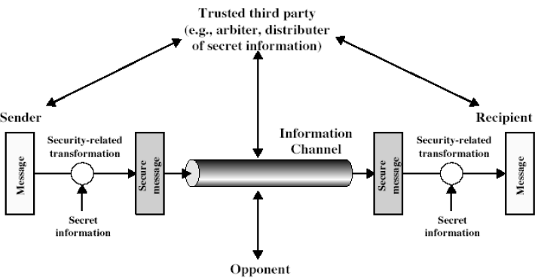
Model for Network Security
Design a suitable algorithm for the security transformation.
Generate the secret information (keys) used by the algorithm.
Develop methods to distribute and share the secret information.
Specify a protocol enabling the principals to use the transformation and secret information for a security service.

Slide 22
The network security model represents the secure communication between sender and receiver. This model depicts how the security service has been implemented over the network to prevent the opponent from causing a threat to the authenticity or confidentiality of the data that is being communicated through the network.
Network security covers a huge amount of technologies, devices and processes
In simple words, it is a set of rules and regulations designed for protecting and securing the integrity, confidentiality and accessibility of data and computer networks.
The most common example of network security is password protection which was chosen by itself.

Slide 23
Importance of Cryptography and Network Security
Cryptography is very important for protecting private information from third-party access. Some of the importance of cryptography are given below:
For secure communication, data transmission and transactions.
To safeguard personal information
For ensuring the data confidentiality
For the protection of data from unauthorized access.
To authenticate the source of data
To establish trust between two communicating parties.
Cryptography provides above all features by converting the sender message into an unreadable format while transmitting over the network so that it can not be accessed by any unauthorized user

Slide 24
Importance of Network Security
To protect sensitive information safe from cyber-attacks.
This is important to secure sensitive data safe from cyber attacks and to ensure that the network is usable and can be trusted
Network security protects the data of the client by ensuring that hackers can not get into your network easily.
Network security also improves the performance of the network by ensuring that the system is not slowed down due to redundant tools and data.
To protect the network from a ransomware attack. Ransomware is a common type of attack that blocks access to your data until you pay the ransom.

Slide 25
Cryptography Applications
Authentication/Digital Signatures
Time Stamping
Electronic Money
Encryption/Decryption in email
WhatsApp Encryption
Instagram Encryption
Sim card Authentication
Network Security Applications
Protection of network.
Protection from intrusions.
To protect from threats.
Protection of data from breaches

Slide 26
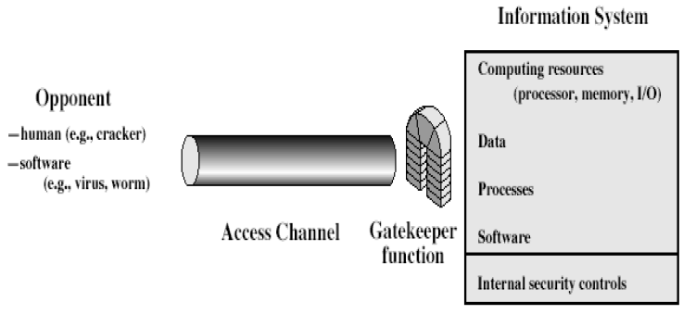
Model for Network Access Security
Select appropriate gatekeeper functions to identify users.
Implement security controls to ensure only authorized users access designated information or resources.

Slide 27
Basic Terminologies in Cryptography
Plain text – Original message in human understandable / readable form.
Cipher text – Coded message i.e., meaningless / in unknown form.
Key – Secret value known to only communicating parties that is used to convert Plain Text to Cipher Text and vice-versa.
Cipher – algorithm for transforming plaintext to ciphertext.
Decipher - recovering plaintext from ciphertext.
Cryptography - study of encryption principles / methods.
Cryptanalysis (code breaking) - study of principles / methods of deciphering ciphertext without knowing key.
Cryptology - field of both cryptography and cryptanalysis.

Slide 28
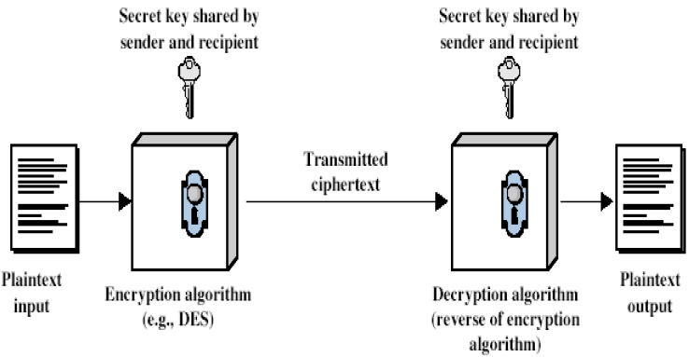
3.Mathematical tool for Cryptography
Symmetric Cipher Model

Slide 29
Requirements of Mathematical Model
Two requirements for secure use of symmetric encryption:
A strong encryption algorithm.
A secret key known only to sender / receiver.
Mathematically we can denote:
Y = E_{K}(X) - Encryption(Sender)
X = D_{K}(Y) - Decryption(Receiver)
Y – Cipher Text; X – Plain Text; E_{K}- Encryption Algorithm;
D_{K}- Decryption Algorithm.
Assuming encryption algorithm is known.
We must now ensure a secure channel to distribute key.

Slide 30
Characterizing any Cryptographic System
1.Type of encryption operations used: substitution & transposition & product.
2.Number of keys used: single-key & private / two-key or public.
3.Way in which plaintext is processed: block & stream.
Cryptanalysis
Objective to recover key not just message.
General approaches
Cryptanalytic attack.
Brute-force attack.

Slide 31
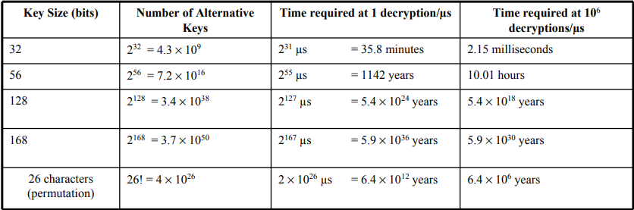
Cryptanalytic & Brute-force Attack
Cryptanalytic Attack
ciphertext only - only know algorithm & ciphertext, is statistical, know or can identify plaintext.
known plaintext - know/suspect plaintext & ciphertext.
chosen plaintext - select plaintext and obtain ciphertext.
chosen ciphertext - select ciphertext and obtain plaintext.
chosen text - select plaintext or ciphertext to en/decrypt.
Brute-force Attack

Slide 32
4.a.Classical Substitution Ciphers
Letters of plaintext are replaced by other letters or by numbers or symbols.
If plaintext is viewed as a sequence of bits, then substitution involves replacing plaintext bit patterns with ciphertext bit patterns.
Types of substitution techniques:
Caesar Cipher.
Monoalphabetic Cipher.
Polyalphabetic Cipher.
Playfair Cipher.
Hill Cipher.
One-Time Pad.

Slide 33
Symmetric Algorithms – Caesar Cipher
Each letter of the plaintext is substituted by another letter to form the ciphertext. It is a simplest form of substitution cipher scheme.
Each alphabet replaced by another alphabet which is ‘shifted’ by some fixed number between 0 and 25. Flskhu
A B C D E F G H I J K L M N O P Q R S T U V W X Y Z
D E F G H I J K L M N O P Q R S T U V W X Y Z A B C
C | I | P | H | E | R
F | L | S | K | H | U

Slide 34
Mathematical Description & Cryptanalysis
First we translate all of our characters to numbers, 'a'=0, 'b'=1, 'c'=2, ... , 'z'=25.
We can now represent the caesar cipher encryption function, e(x), where x is the character we are encrypting, as:
c=E(p) = (p + k) (mod 26)
k is the key (the shift) applied to each letter.
After applying this function the result is a number which must then be translated back into a letter. The decryption function is :
p=D(c) = (c - k) (mod 26)
Only have 26 possible ciphers i.e., A maps to A,B,..Z

Slide 35
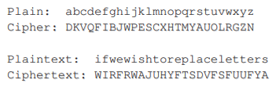
II.Monoalphabetic Cipher
Rather than just shifting the alphabet
Could shuffle (jumble) the letters arbitrarily
Each plaintext letter maps to a different random ciphertext letter
Key is 26 letters long
Total of 26! = 4 x 1026 keys
With so many keys, might think is secure.

Slide 36
Language Redundancy and Cryptanalysis
Problem is language characteristics, human languages are redundant.
eg "th lrd s m shphrd shll nt wnt"
Letters are not equally commonly used.
In English E is by far the most common letter followed by T,R,N,I,O,A,S.
Other letters like Z,J,K,Q,X are fairly rare.
Have tables of single, double & triple letter frequencies for various languages.
Compare counts / plots against known values.
Tables of common double / triple letters help to identify relations among letters.

Slide 37
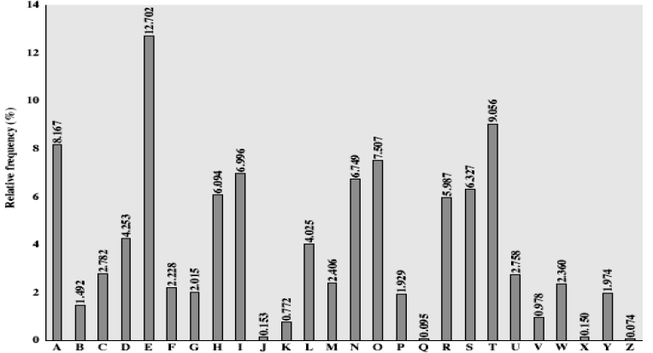
English Letter Frequencies

Slide 38
III.Polyalphbetic Cipher
Improve security using multiple cipher alphabets
Makes cryptanalysis harder with more alphabets to guess and flatter frequency distribution.
Uses a key to select which alphabet is used for each letter of the message.
Uses each alphabet and repeats from start after end of key is reached.
Vigenere Cipher
Simplest and effectively multiple caesar ciphers. Keys are many letters long K = k₁ k₂...k_{d} .
i^{th} letter specifies i^{th} alphabet to use
Use each alphabet in turn, repeats from start after d letters in message. Decryption simply works in reverse.

Slide 39

Example & Security of Vigenere Cipher
Write the plaintext out.
Write the keyword repeated above it.
Use each key letter as a caesar cipher key.
Encrypt the corresponding plaintext letter eg. using keyword deceptive.
For decryption check for key against its cipher value’s Plaintext.
Have multiple cipher text letters for each plaintext letter
Letter frequencies are obscured but not totally lost.
Start with letter frequencies and determine number of alphabets.

Slide 40
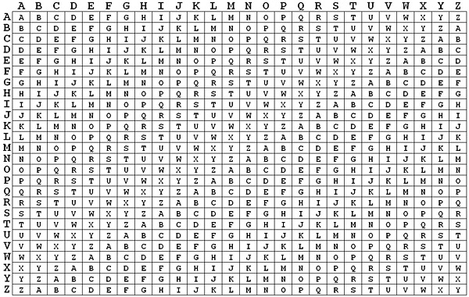
Vigenere Tabulae
Plain Text
KEY

Slide 41
Kasiski Method & Autokey Cipher
Developed by Babbage / Kasiski repetitions in ciphertext give clues.
Can find same plaintext an exact period apart which results in the same ciphertext.
Could also be random fluke.
Autokey Cipher
Ideally want a key as long as the message.
Vigenère proposed the autokey cipher with keyword is prefixed to message as key.
Knowing keyword can recover the first few letters, use these in turn on the rest of the message.
Still can have frequency characteristics to attack.

Slide 42
IV.Playfair Cipher
Not even the large number of keys in a monoalphabetic cipher provides security.
One approach to improving security was to encrypt multiple letters.
The Playfair Cipher is an example.
Invented by Charles Wheatstone in 1854, but named after his friend Baron Playfair.
A 5X5 matrix of letters based on a keyword.
Fill in letters of keyword in the matrix.
Fill rest of matrix with other letters. eg. Keyword : MONARCHY
Contributed by Himanshu (@nycanshu)

Slide 43
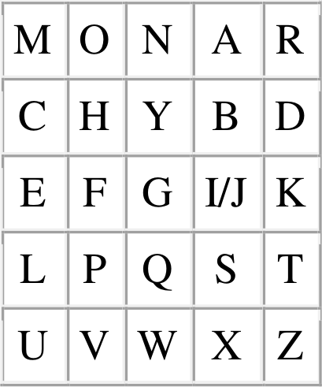
Encrypting & Decrypting
Plaintext is encrypted two letters(digrams) at a time
1. If a pair is a repeated letter, insert filler like ‘x’.
2. If both letters fall in the same row, replace each with letter to right (wrapping back to start from end)
3. If both letters fall in the same column, replace each with the letter below it (again wrapping to top from bottom)
4. Otherwise each letter is replaced by the letter in the same row and in the column of the other letter of the pair.

Slide 44
Encrypting & Decrypting
Encryption
PlainText: "instruments"
After Split: 'in' 'st' 'ru' 'me' 'nt' 'sx‘
Cipher Text: GATLMZCLRQXA
Decryption
Cipher Text: GATL MZCLRQXA
Reverse the above process.
Same Column | Same Row | Otherwise
Diagraph: "me" Encrypted Text: CL Encryption: m -> C e -> L | Diagraph: "st" Encrypted Text: TL Encryption: s -> T t -> L | Diagraph: "nt" Encrypted Text: RQ Encryption: n -> R t -> Q

Slide 45
Security of Playfair Cipher
Security much improved over monoalphabetic since have 26 x 26 = 676 digrams.
Would need a 676 entry frequency table to analyse (verses 26 for a monoalphabetic) and correspondingly more ciphertext was widely used for many years. eg. by US & British military in World War-1
It can be broken, given a few hundred letters since still has much of plaintext structure.

Slide 46
V.Hill Cipher
Hill cipher is a polygraphic substitution cipher based on linear algebra.
Each letter is represented by a number modulo 26. Often the simple scheme A = 0, B = 1, …, Z = 25 is used, but this is not an essential feature of the cipher.
To encrypt a message, each block of n letters is multiplied by an invertible n × n matrix, against modulus 26.
To decrypt the message, each block is multiplied by the inverse of the matrix used for encryption.
The matrix used for encryption is the cipher key, and it should be chosen randomly from the set of invertible n × n matrices (modulo 26).

Slide 47
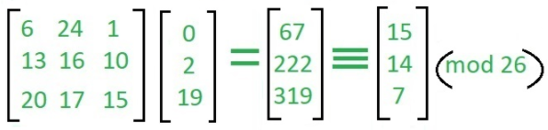
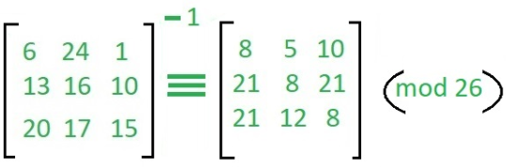
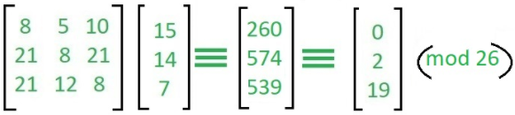
Encryption & Decryption
Input : Plaintext: act
Key: GYBNQKURP
Output : Ciphertext: POH
Encryption
Decryption

Slide 48
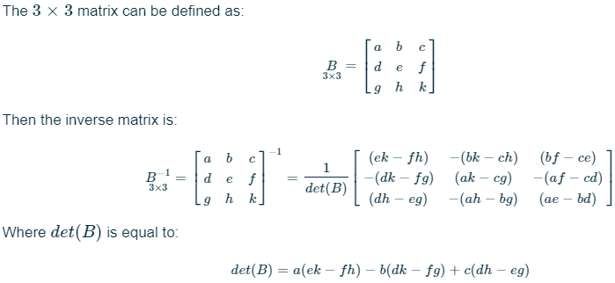
Inverse of a 3 × 3 Matrix

Slide 49
VI.One-Time Pad / Vernam Cipher
If a truly random key as long as the message is used, the cipher will be secure.
Is unbreakable since ciphertext bears no statistical relationship to the plaintext.
For any plaintext & any ciphertext there exists a key mapping one to other.
Can only use the key once.
Problems will be in generation & safe distribution of key.

Slide 50
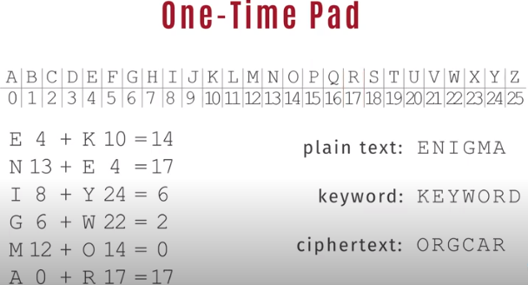
Encryption & Decryption

Slide 51
4.b.Transposition Cipher
These hide the message by rearranging the letter order.
Without altering the actual letters used.
Can recognize these, since have the same frequency distribution as the original text.
2 approaches: i.Railfence and ii.Columnar Transposition Cipher.
i.Railfence
Write message letters out diagonally over a number of rows then read off cipher row by row. Plain Text: meet me after the toga party.
Depth(Key): 2
Eg. m e m a t r h t g p r y - First-half of Ciphertext
e t e f e t e o a a t - Second-half of Ciphertext
Ciphertext : MEMATRHTGPRY ETEFETEOAAT

Slide 52
ii.Columnar Transposition Ciphers
A more complex transposition write letters of message out in rows over a specified number of columns.
Reorder the columns according to some key before reading off the rows.
Plaintext : attack postponed until two am.
Key : 4 3 1 2 5 6 7
Plaintext : a t t a c k p
o s t p o n e
d u n t i l t
w o a m x y z
Ciphertext1: TTNA APTM TSUO AODW COIX KNLY PETZ

Slide 53
Double Columnar Transposition Ciphers
A pure transposition cipher is easily recognized because it has the same letter frequencies as the original plaintext.
Perform more than one stage of transposition.
Key: 4 3 1 2 5 6 7
Input:
t t n a a p t
m t s u o a o
d w c o i x k
n l y p e t z
Cipher Text2: NSCY AUOP TTWL TMDN AOIE PAXT TOKZ

Slide 54
4.c.Product Cipher
Ciphers using substitutions or transpositions are not secure because of language characteristics.
Considers using several ciphers in succession to make harder.
Two substitutions make a more complex substitution.
Two transpositions make more complex transposition.
A substitution followed by a transposition makes a new much harder cipher.
Acts as a bridge from classical to modern ciphers.

Slide 55
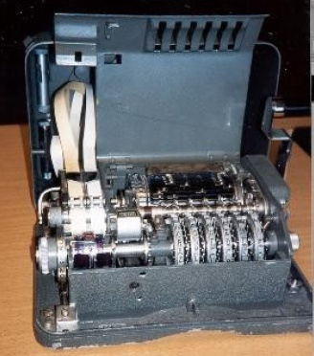
Rotor Machines
Before modern ciphers, rotor machines were most common complex ciphers in use .
Widely used in World War 2
- German Enigma, Allied Hagelin, Japanese Purple.
Implemented a very complex, varying substitution cipher.
Used a series of cylinders, each giving one substitution, which rotated and changed after each letter was encrypted.
With 3 cylinders have 26³=17576 alphabets.
Hagelin Rotor Machine →→→→→→→→

Slide 56
Steganography
An alternative to encryption.
Hides existence of message.
Use of a subset of letters/words in a longer message marked in some way.
Use of character marking, invisible ink, pin punctures and type written correction ribbon.
Hiding in LSB in graphic image or sound file.
Drawbacks
High overhead to hide relatively few info bits of information.
Once the system is discovered, it becomes virtually worthless.

Slide 57
5.Design principles of block ciphers
Modern Block Ciphers
Most widely used types of cryptographic algorithms.
Provides secrecy /authentication services.
Focuses on DES (Data Encryption Standard).
Block vs Stream Ciphers
Block ciphers - messages in blocks, each of which is then en/decrypted like a substitution on very big characters 64-bits or more.
Stream ciphers - messages processed in bit or byte at a time when en/decrypting.
Many current ciphers are block ciphers.
Broader range of applications.

Slide 58
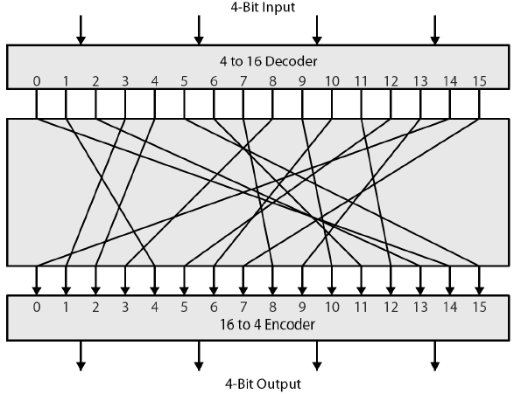
Ideal Block Cipher
Most symmetric block ciphers are based on a Feistel Cipher Structure.
Must be able to decrypt ciphertext to recover messages efficiently.
Block ciphers look like an extremely large substitution.
Would need table of 2⁶⁴ entries for a 64-bit block.
Instead create from smaller building blocks using idea of a product cipher.

Slide 59
Claude Shannon’s Substitution-Permutation Ciphers
Introduced idea of substitution-permutation (S-P) networks in 1949 paper.
Forms basis of modern block ciphers.
S-P nets are based on the two primitive cryptographic operations seen before: substitution (S-box) and permutation (P-box).
Provides both confusion & diffusion of message & key.
Diffusion – dissipates statistical structure of plaintext over bulk of ciphertext.
Confusion – makes relationship between ciphertext and key as complex as possible.

Slide 60
Feistel Cipher
Horst Feistel devised the feistel cipher based on concept of invertible product cipher.
Partitions input block into two halves and process through multiple rounds.
Performs substitution on left data half.
Uses round function on right half data with a subkey.
Then have permutation swapping halves.
Design Elements of Feistel Cipher
Block size, key size, number of rounds.
Subkey generation algorithm.
Round function.
Fast software en/decryption & ease of analysis.

Slide 61
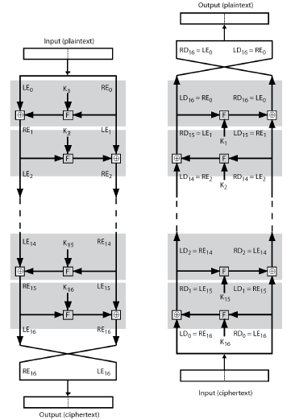
Feistel Encryption & Decryption
Encryption Decryption

Slide 62
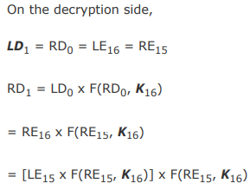
Decryption in Feistel Cipher

Slide 63
6.Data Encryption Standard(DES)
Most widely used block cipher in world, adopted in 1977 by NBS (National Bureaue of Standards) now National Institute of Standards & Technology as FIPS PUB 46.
Encrypts 64-bit blocks of data using 56-bit key.
Has widespread use, has been considerable, besides controversy over its security.
DES History
IBM developed Lucifer cipher by team led by Feistel in late 60’s.
Used 64-bit data blocks with 128-bit key.
IBM submitted their revised Lucifer which was eventually accepted as the DES.

Slide 64
DES Design Controversy
Although DES standard is public, it had considerable controversy over design.
In choice of 56-bit key (vs Lucifer 128-bit).
Because design criteria were classified.
Subsequent events and public analysis show in fact design was appropriate.
Use of DES has flourished, especially in financial applications.
Still standardized for legacy application use.

Slide 65
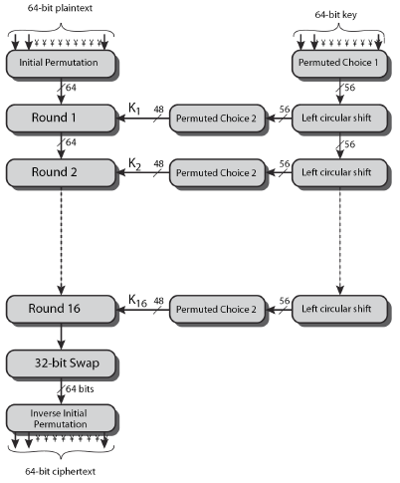
DES Encryption Overview

Slide 66
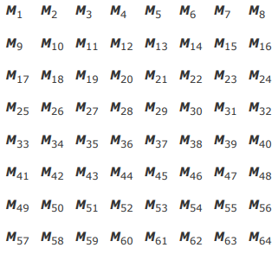

Permutations in DES
Two permutation functions are indeed the inverse of each other, consider the following 64-bit input M:
where Mi is a binary digit. Then the permutation X = IP(M) is as follows:
If we then take the inverse permutation Y = IP⁻¹(X) = IP⁻¹(IP(M)), it can be seen that the original ordering of the bits is restored.

Slide 67
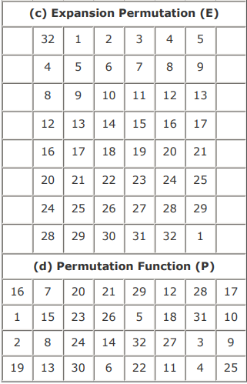
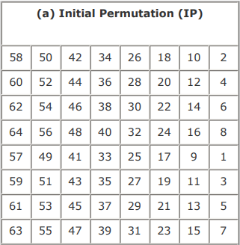
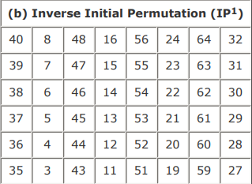

Permutations in DES
First step of the data computation.
IP reorders the input data bits.
Even bits to LH half, odd bits to RH half.
Quite regular in structure (easy in h/w).

Slide 68
DES Round Structure
Uses two 32-bit L & R halves as for any Feistel cipher can describe as: Li = Ri–1 and Ri = Li–1 XOR F(Ri–1 , Ki)
F takes 32-bit R half and 48-bit subkey:
- expands R to 48-bits using permutation E.
- adds to subkey using XOR
- passes through 8 S-boxes to get 32-bit result
- finally permutes using 32-bit perm P

Slide 69
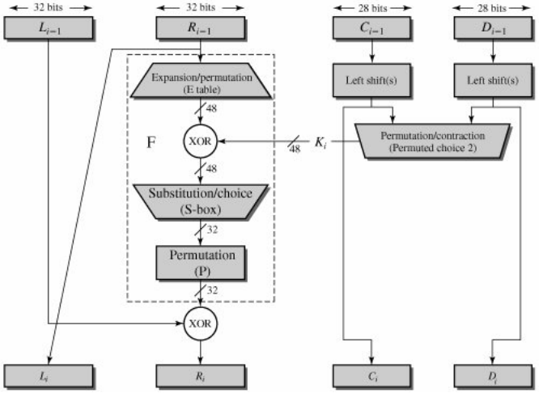
Single Round of DES

Slide 70
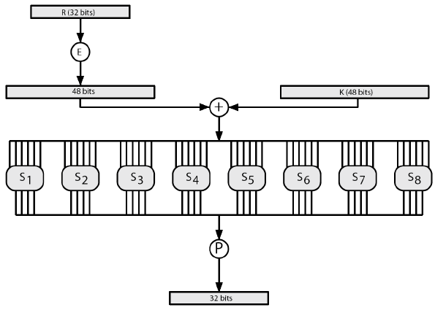
S-Boxes in DES
Have eight S-boxes which map 6 to 4 bits each S-box is actually 4 little, 4 bit boxes.
Outer bits 1 & 6 (row bits) select one row of 4.
Inner bits 2-5 (col bits) are substituted.
Result is 8 lots of 4 bits, or 32 bits.
Row selection depends on both data & key. Feature known as autoclaving (autokeying).

Slide 71
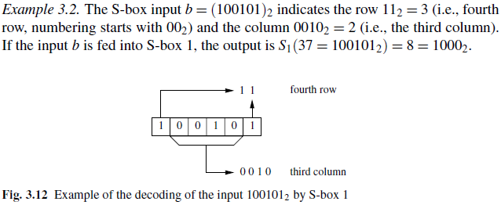
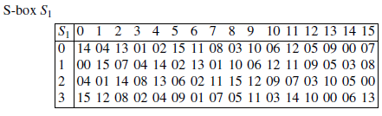
Decoding of the Input by S-Box 1

Slide 72
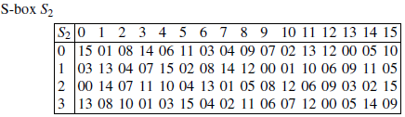
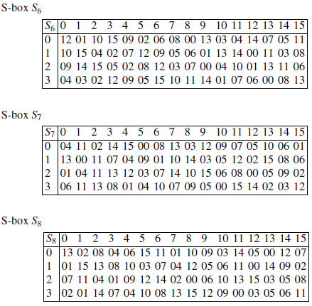
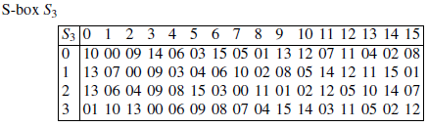
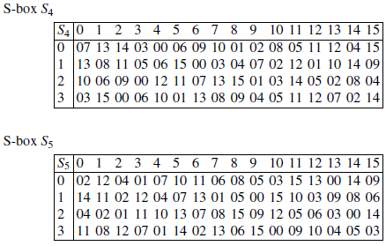
Substitution Boxes S

Slide 73
DES Key Schedule
Forms sub-keys used in each round.
Initial permutation of the key (PC1) which selects 56-bits in two 28-bit halves.
16 stages consisting of rotating each half separately either 1 or 2 places.
Depending on the key rotation schedule K.
Selecting 24-bits from each half & permuting them by PC2 for use in round function F.
Note: Practical use issues in h/w vs s/w

Slide 74
DES Decryption
Decrypt must unwind steps of data computation.
Similar with Feistel design, do encryption steps again using sub-keys in reverse order (SK16 … SK1).
- IP undoes final FP step of encryption.
- 1st round with SK16 undoes 16th encrypt round.
….
- 16th round with SK1 undoes 1st encrypt round.
- Final FP undoes initial encryption IP.
- Thus recovering original data value.

Slide 75
Avalanche Effect
Key desirable property of encryption algorithm.
A change of one input or key bit results in changing approx half output bits.
Making attempts to “home-in” by guessing keys impossible.
DES exhibits strong avalanche.
Strength of DES – Key Size
56-bit keys have 2⁵⁶ = 7.2 x 10¹⁶ values
Brute force search looks hard. However recent advances have shown that it is possible to break key:
- in 1997 on Internet in a few months, in 1998 on dedicated h/w (EFF) in a few days and in 1999 above combined in 22hrs!.
Still must be able to recognize plaintext.

Slide 76
DES against Analytic Attacks
Now have several analytic attacks on DES
These utilize some deep structure of the cipher by gathering information about encryptions
Can eventually recover some/all of the sub-key bits
If necessary then exhaustively search for the rest
Generally these are statistical attacks which includes:
- differential cryptanalysis
- linear cryptanalysis
- related key attacks

Slide 77
DES against Timing & Cryptanalysis Attacks
Attacks actual implementation of cipher.
Use knowledge of consequences of implementation to derive information about: Some / all sub-key bits.
Specifically use fact that calculations can take varying times depending on the value of the inputs to it.
Particularly problematic on smartcards.
Differential Cryptanalysis
A statistical attack against Feistel ciphers uses cipher structure not previously used.
Design of S-P networks has output of function f influenced by both input & key.
Cannot trace values back through cipher without knowing value of the key.
Differential cryptanalysis compares two related pairs of encryptions.

Slide 78
DES Design Criteria
as reported by Coppersmith in [COPP94]
7 criteria for S-boxes provide for
- non-linearity
- resistance to differential cryptanalysis
- good confusion
3 criteria for permutation P provide for
- increased diffusion

Slide 79
7.Origin of AES
Clear a replacement for DES was needed have theoretical attacks that can break it.
Demonstrated exhaustive key search attacks.
Can use Triple-DES – but slow with small blocks.
US NIST issued call for ciphers in 1997.
15 candidates accepted in Jun 98 and 5 were shortlisted in Aug-99.
Rijndael was selected as the AES in Oct-2000.
Issued as FIPS PUB 197 standard in Nov-2001.

Slide 80
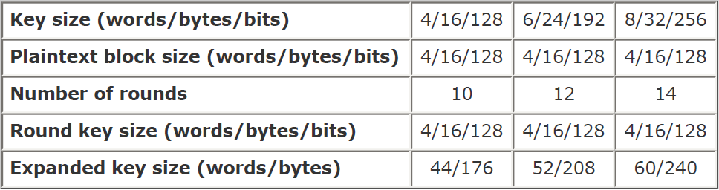
AES Requirements
Private key symmetric block cipher 128-bit data, 128/192/256-bit keys
Stronger & faster than Triple-DES.
Active life of 20-30 years (+ archival use).
Provides full specification & design details.
Supports both C & Java implementations.
NIST have released all submissions & unclassified analyses.

Slide 81
AES Evaluation Criteria
Initial Criteria
security – effort to practically cryptanalyse
cost – computational
algorithm & implementation characteristics
Final criteria
general security
software & hardware implementation ease
implementation attacks
flexibility (in en/decrypt, keying, other factors)

Slide 82
AES Shorlist
After testing and evaluation, shortlist in Aug-99:
- MARS (IBM) - complex, fast, high security margin.
- RC6 (USA) - v. simple, v. fast, low security margin.
- Rijndael (Belgium) - clean, fast, good security margin.
- Serpent (Euro) - slow, clean, v. high security margin.
- Twofish (USA) - complex, v. fast, high security margin.
Then subject to further analysis & comment saw contrast between algorithms.
Few complex rounds verses many simple rounds which refined existing ciphers verses new proposals.

Slide 83
The AES Cipher - Rijndael
Designed by Rijmen-Daemen in Belgium has 128/192/256 bit keys, 128 bit data.
An iterative rather than feistel cipher treats data in 4 groups of 4 bytes.
Operates an entire block in every round.
Designed to be resistant against known attacks.
Speed and code compactness on many CPUs & design simplicity
Has 9/11/13 rounds in which state undergoes:
– byte substitution (1 S-box used on every byte)
– shift rows (permute bytes between groups/columns)
– mix columns (subs using matrix multipy of groups)
– add round key (XOR state with key material)
Initial XOR key material & incomplete last round
All operations can be combined into XOR and table lookups - hence very fast & efficient

Slide 84
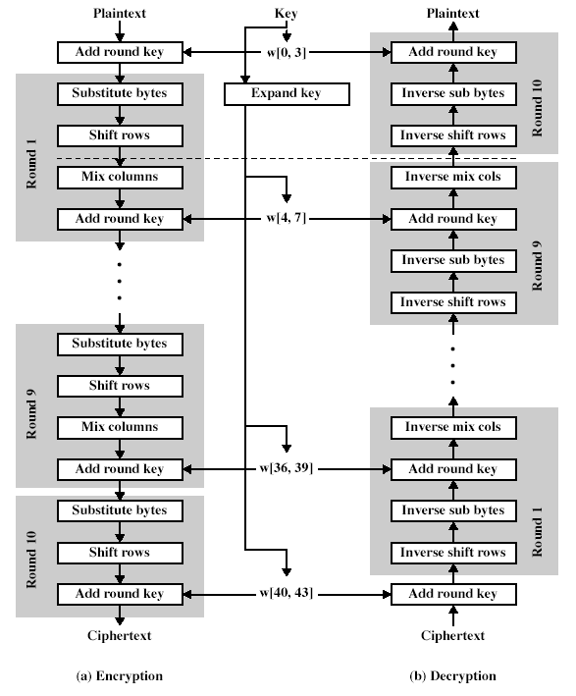
The AES Cipher - Rijndael

Slide 85
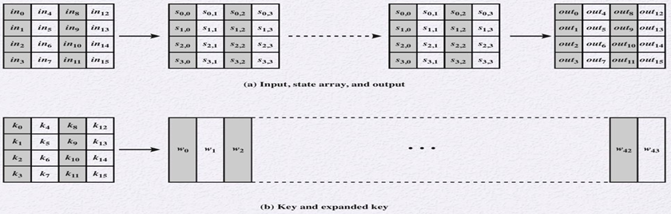
AES Data Structures

Slide 86
Byte Substitution
A simple substitution of each byte.
Uses one table of 16x16 bytes containing a permutation of all 256 8-bit values.
Each byte of state is replaced by byte in row (left 4-bits) & column (right 4-bits)
eg. byte {95} is replaced by row 9 col 5 byte which is the value {2A}.
S-box is constructed using a defined transformation of the values in Galois Field(2⁸)
Designed to be resistant to all known attacks.

Slide 87
Shift Rows
A circular byte shift in each each
1st row is unchanged.
2nd row does 1 byte circular shift to left.
3rd row does 2 byte circular shift to left.
4th row does 3 byte circular shift to left.
Decryption does shifts to right.
State is processed by columns, this step permutes bytes between the columns.

Slide 88
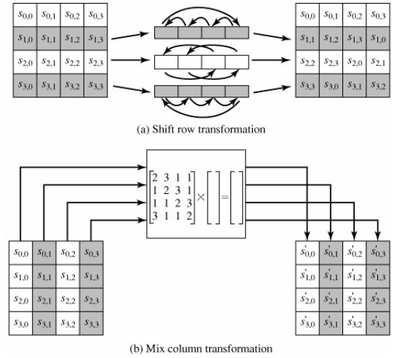
Mix Columns
Each column is processed separately.
Each byte is replaced by a value dependent on all 4 bytes in the column.
Effectively a matrix multiplication in GF(2⁸).

Slide 89
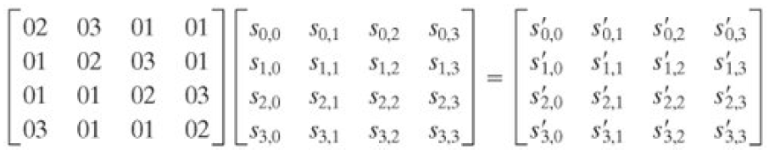
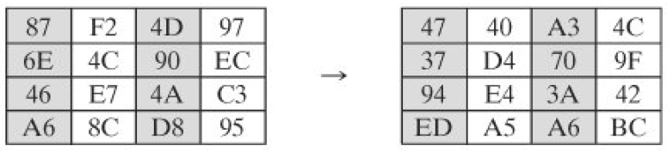
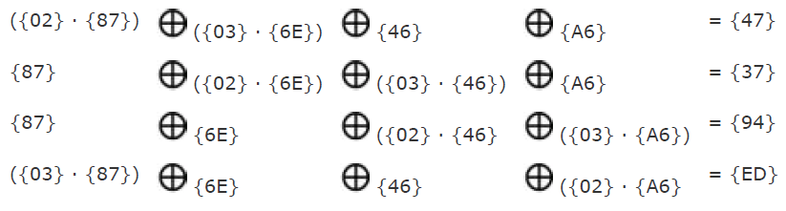
Mix Columns

Slide 90
Add Round Key
XOR state with 128-bits of the round key.
Processed by column (though effectively a series of byte operations)
inverse for decryption is identical since XOR is own inverse, just with correct round key.
Designed to be as simple as possible.

Slide 91
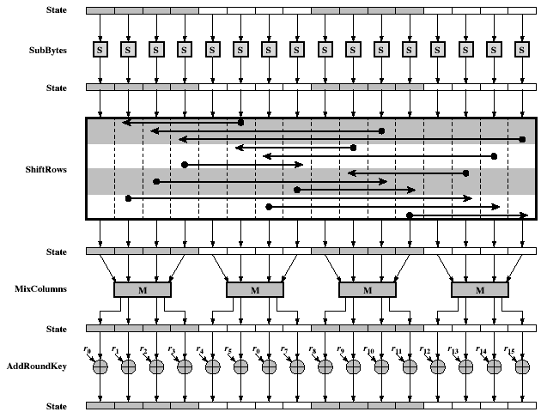
AES Round

Slide 92
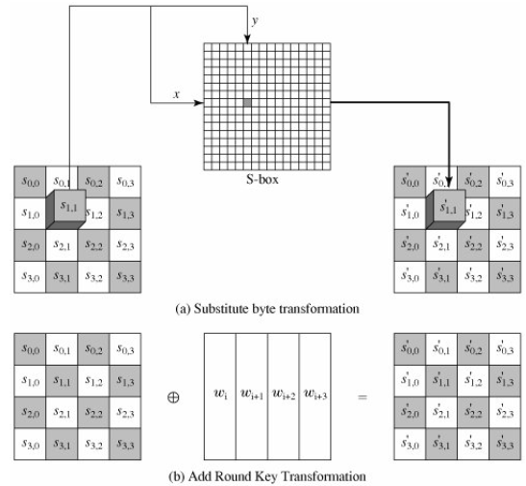
AES S-Box

Slide 93
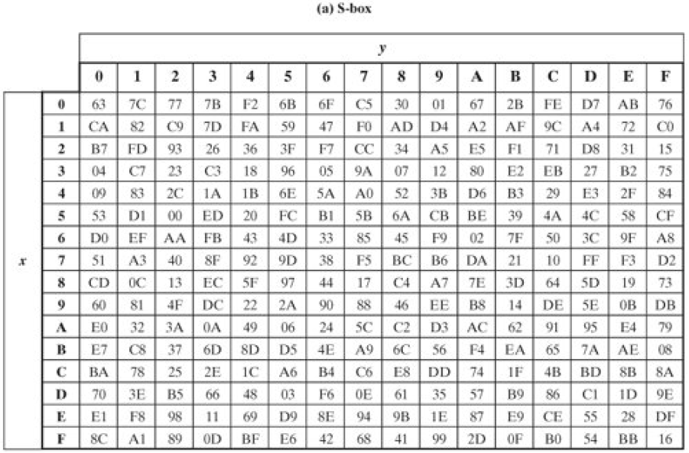
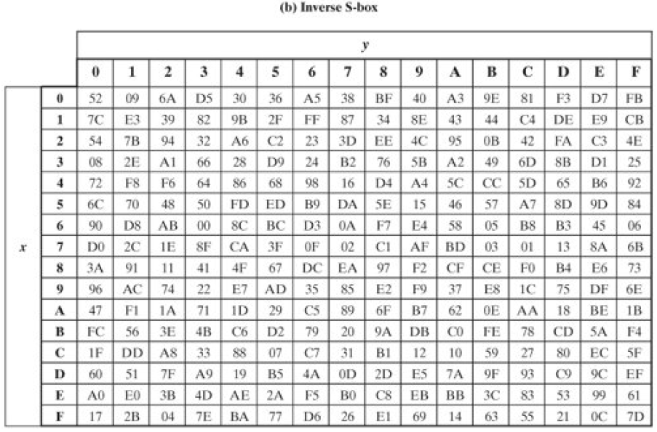
S-Box & Inverse S-Box

Slide 94
AES Transformations
The hexadecimal value {95} references row 9, column 5 of the S-box, which contains the value {2A}.
Accordingly, the value {95} is mapped into the value {2A} in inverse S-box.
The S-box is not self inverse.
That it is not true that S-box(a) = IS-box(a). For example, [S-box({95}) = {2A}, but IS-box({95}) = {AD}.

Slide 95
AES Key Expansion
Takes 128-bit (16-byte) key and expands into array of 44/52/60 32-bit words
Start by copying key into first 4 words.
Then loop creating words that depend on values in previous & 4 places back .
- In 3 of 4 cases just XOR these together.
- Every 4th has S-box + rotate + XOR constant of previous before XOR together.
Designed to resist known attacks.

Slide 96
AES Decryption
AES decryption is not identical to encryption since steps done in reverse
Define an equivalent inverse cipher with steps as for encryption
– but using inverses of each step
– with a different key schedule
Works since result is unchanged when
– swap byte substitution & shift rows
– swap mix columns & add (tweaked) round key

Slide 97
Implementation Aspects of AES
can efficiently implement on 8-bit CPU.
– byte substitution works on bytes using a table of 256 entries.
– shift rows is simple byte shifting.
– add round key works on byte XORs.
– mix columns requires matrix multiply in GF(2⁸) which works on byte values, can be simplified to use a table lookup.
can efficiently implement on 32-bit CPU.
– redefine steps to use 32-bit words.
– can precompute 4 tables of 256-words.
– then each column in each round can be computed using 4 table lookups + 4 XORs.
– at a cost of 16Kb to store tables.
Designers believe this very efficient implementation was a key factor in its selection as the AES cipher.

Slide 98

8.Triple DES
An alternative to AES or the AES finalist algorithms is triple DES, often denoted as 3DES.
3DES consists of three subsequent DES encryptions with different keys. Given by, y = DES_{k3} (DES_{k2} (DES_{k1} (x)))
3DES seems resistant to both brute-force attacks and any analytical attack imaginable at the moment.
Another version of 3DES is:
The advantage here is that 3DES performs single DES encryption if k3 = k2 = k1, which is sometimes desired in implementations that should also support single DES.
3DES is very efficient in hardware but not particularly in software.
It is popular in financial applications as well as for protecting biometric information in electronic passports.

Slide 99
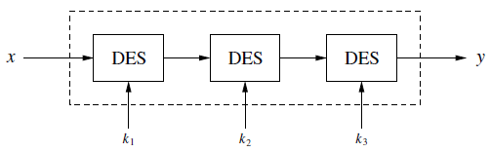
3-DES
A different approach for strengthening DES is to use key whitening.
For this, two additional 64-bit keys k1 and k2 are XORed to the plaintext and ciphertext, respectively, prior to and after the DES algorithm.
This yields the following encryption scheme.
This surprisingly simple modification makes DES much more resistant against exhaustive key searches.

Slide 100

9.RC5
The word size (i.e. input plaintext block size), number of rounds and number of keys are not fixed i.e. all can be of variable length.
Once w, r, k (word size, number of rounds, number of keys) are finalized then they remain same for all the rounds.
Plain text can be 32 bits, 64 bits or 128 bits.
Number of rounds can be between 0-255.
Key size can be between 0 to 255 bytes.

Slide 101
Components in RC5
Consists of three components a key expansion algorithm an encryption algorithm and a decryption algorithm.
The plaintext input to RC5 consists of two w-bit words which we denote A and B.
RC5 uses an expanded key table S[0....t-1] consisting of t=2(r+1) w-bit words.
The key expansion algorithm initializes S from the user's given secret key parameter K.
We assume standard little-endian conventions for packing bytes into input / output blocks:
The first byte occupies the low-order bit positions of register A and so on, so that the fourth byte occupies the high-order bit positions in A, the fifth byte occupies the low order bit positions in B and the eighth (last) byte occupies the high-order bit positions in B.

Slide 102



A.Key Expansion in RC5
Expands the user's secret key K to fill the expanded key array S, so that S resembles an array of t = 2(r+1) random binary words determined by K.
The key expansion algorithm uses two magic constants and consists of three simple algorithmic parts.
Step 1: The key-expansion algorithm uses two word-sized binary constants P and Q. They are defined for arbitrary w = 16, 32 and 64 as:

Slide 103


A.Key Expansion in RC5
Step 2: Converting secret key K from bytes to words.
Secret key K of size b bytes is used to initialize array L consisting of c words where c = b/u, u = w/8 and w = word size used for that particular instance of RC5.
For example, if we choose w=32 bits and Key k is of size 96 bytes then, u=32/8=4, c=b/u=96/4=24.
L is pre initialized to 0 value before adding secret key K to it.
Step 3:Initializing sub-key S.
Sub-key S of size t=2(r+1) is initialized using magic constants P and Q.

Slide 104

Steps in Encryption
Step 4:Sub-key mixing.
The RC5 encryption algorithm uses Sub key S. L is merely, a temporary array formed on the basis of user entered secret key.
Mix in user’s secret key with S and L.
Step-5:Encryption.
We divide the input plain text block into two registers A and B each of size w bits.
After undergoing the encryption process the result of A and B together forms the cipher text block.

Slide 105
Steps in Encryption
RC5 Encryption Algorithm:
One time initialization of plain text blocks A and B by adding S[0] and S[1] to A and B respectively. These operations are mod.
XOR A and B. A=A^B
Cyclic left shift new value of A by B bits.
Add S[2*i] to the output of previous step. This is the new value of A.
XOR B with new value of A and store in B.
Cyclic left shift new value of B by A bits.
Add S[2*i+1] to the output of previous step. This is the new value of B.
Repeat entire procedure (except one time initialization) r times.

Slide 106


Steps in Encryption & Decryption
Encryption
Decryption

Slide 107
10.Modes of Operations in Block Cipher
A block cipher algorithm is a basic building block for providing data security.
To apply a block cipher in a variety of applications, four "modes of operation" have been defined by NIST.
Covers virtually all the possible applications of encryption for which a block cipher could be used.
As new applications and requirements have appeared, NIST has expanded the list of recommended modes to five in Special Publication 800-38A.
These modes are intended for use with any symmetric block cipher, including triple DES and AES.

Slide 108

Modes of Operations in Block Cipher

Slide 109
A.Electronic Codebook Mode
Plaintext is handled one block at a time and each block of plaintext is encrypted using the same key.
Codebook-for a given key, there is a unique ciphertext for every b-bit block of plaintext.
For a sequence of b-bit blocks, P1, P2,...,PN; the corresponding sequence of ciphertext blocks is C1, C2,..., CN.
For a message longer than b bits, the procedure is simply to break the message into b-bit blocks, padding the last block if necessary.
Decryption is performed one block at a time, always using the same key.
Ideal for a short amount of data, such as an encryption key.
If you want to transmit a DES key securely, ECB is the appropriate mode to use.

Slide 110

A.Electronic Codebook Mode

Slide 111
B.Cipher Block Chaining Mode
A technique in which the same plaintext block, if repeated, produces different ciphertext blocks.
The input to the encryption algorithm is the XOR of the current plaintext block and the preceding ciphertext block; the same key is used for each block.
In effect, we have chained together the processing of the sequence of plaintext blocks.
The input to the encryption function for each plaintext block bears no fixed relationship to the plaintext block.
For decryption, each cipher block is passed through the decryption algorithm.
The result is XORed with the preceding ciphertext block to produce the plaintext block.

Slide 112

B.Cipher Block Chaining Mode
An initialization vector (IV) is XORed with the first block of plaintext.
On decryption, the IV is XORed with the output of the decryption algorithm to recover the first block of plaintext.
The IV is a data block that is that same size as the cipher block.
The IV must be known to both the sender and receiver but be unpredictable by a third party.

Slide 113

B.Cipher Block Chaining Mode

Slide 114
C.Cipher Feedback Mode
The DES scheme is essentially a block cipher technique that uses b-bit blocks. However, it is possible to
Converts DES into a stream cipher, using either the cipher feedback (CFB) or the output feedback mode.
A stream cipher eliminates the need to pad a message to be an integral number of blocks. It also can operate in real time.
One desirable property of a stream cipher is that the ciphertext be of the same length as the plaintext.
The unit of transmission is s bits; a common value is s = 8. As with CBC.
The units of plaintext are chained together, so that the ciphertext of any plaintext unit is a function of all the preceding plaintext.
In this case, rather than units of b bits, the plaintext is divided into segments of s bits.

Slide 115
C.Cipher Feedback Mode
The input to the encryption function is a b-bit shift register that is initially set to some initialization vector (IV).
The leftmost (most significant) s bits of the output of the encryption function are XORed with the first segment of plaintext P1 to produce the first unit of ciphertext C1, which is then transmitted.
In addition, the contents of the shift register are shifted left by s bits and C1 is placed in the rightmost (least significant) s bits of the shift register.
This process continues until all plaintext units have been encrypted.
For decryption, the same scheme is used, except that the received ciphertext unit is XORed with the output of the encryption function to produce the plaintext unit.

Slide 116

C.Cipher Feedback Mode

Slide 117
D.Output Feedback Mode
Similar in structure to that of CFB the output of the encryption function that is fed back to the shift register in OFB, whereas in CFB the ciphertext unit is fed back to the shift register.
Bit errors in transmission do not propagate.
More vulnerable to a message stream modification attack.
Complementing a bit in the ciphertext complements the corresponding bit in the recovered plaintext.
Controlled changes to the recovered plaintext can be made.
This may make it possible for an opponent, by making the necessary changes to the checksum portion of the message as well as to the data portion.

Slide 118

D.Output Feedback Mode

Slide 119
E.Counter Mode
Interest in the counter mode (CTR) has increased recently, with applications to ATM (asynchronous transfer mode) network security and IPSec (IP security), this mode was proposed early on.
A counter, equal to the plaintext block size is used.
The only requirement stated in SP 800-38A is that the counter value must be different for each plaintext block that is encrypted.
The counter is initialized to some value and then incremented by 1 for each subsequent block (modulo 2b where b is the block size).
For encryption, the counter is encrypted and then XORed with the plaintext block to produce the ciphertext block; there is no chaining.
For decryption, the same sequence of counter values is used, with each encrypted counter XORed with a ciphertext block to recover the corresponding plaintext block.

Slide 120
E.Counter Mode
Hardware efficiency: Encryption (or decryption) in CTR mode can be done in parallel on multiple blocks of plaintext or ciphertext.
For the chaining modes, the algorithm must complete the computation on one block before beginning on the next block.
In CTR mode, the throughput is only limited by the amount of parallelism that is achieved.
Software efficiency: Processors that support parallel features, such as aggressive pipelining, multiple instruction dispatch per clock cycle, a large number of registers, and SIMD instructions, can be effectively utilized.
Preprocessing: The execution of the underlying encryption algorithm does not depend on input of the plaintext or ciphertext.
If sufficient memory is available and security is maintained, preprocessing can be used to prepare the output of the encryption boxes that feed into the XOR functions

Slide 121

E.Counter Mode

